Slide 1
Chapter 14
How to work with inheritance

Slide 2
Objectives (part 1)
Applied
Use any of the features of inheritance that are presented in this chapter as you develop the classes for your applications.
Knowledge
Explain how inheritance is used within the .NET classes and how you can use it in your own classes.
Explain why you might want to override the ToString(), Equals(), and GetHashCode() methods of the Object class as you develop the code for a new class.
Describe the use of the protected and virtual access modifiers for the members of a class.
Describe the use of polymorphism.
Describe the use of the Type class.

Slide 3
Objectives (part 2)
Describe the use of explicit casting when working with the objects of a base class and its derived classes.
Distinguish between an abstract class and a sealed class.

Slide 4
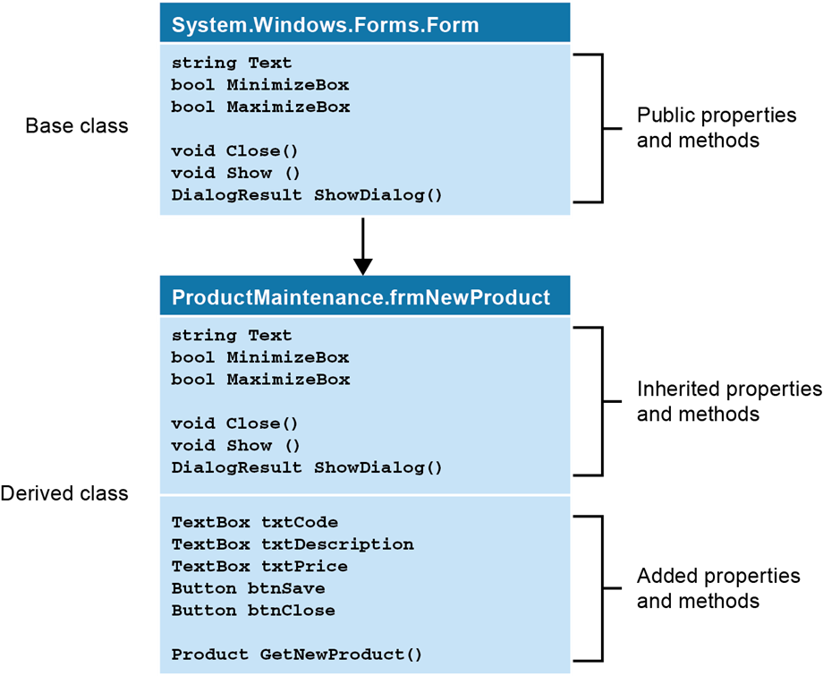
How inheritance works

Slide 5
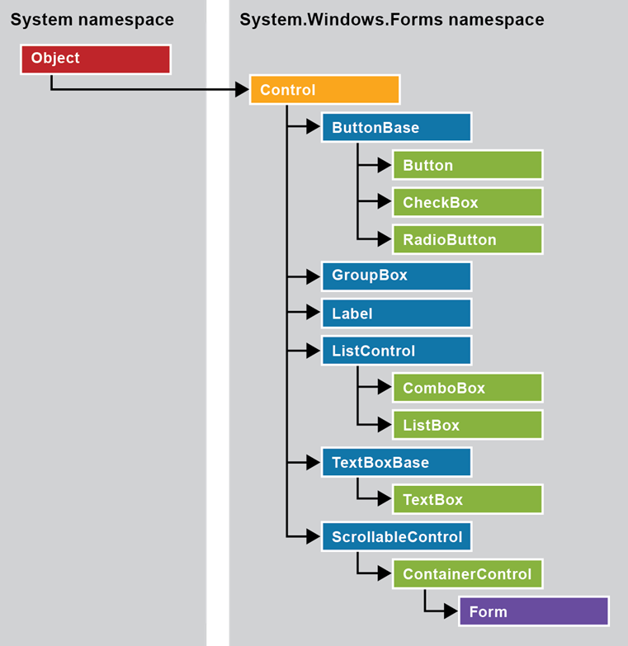
The inheritance hierarchy for form control classes

Slide 6
Methods of the System.Object class
ToString()
Equals(object)
Equals(object1, object2)
ReferenceEquals(object1, object2)
GetType()
GetHashCode()
Finalize()
MemberwiseClone()

Slide 7
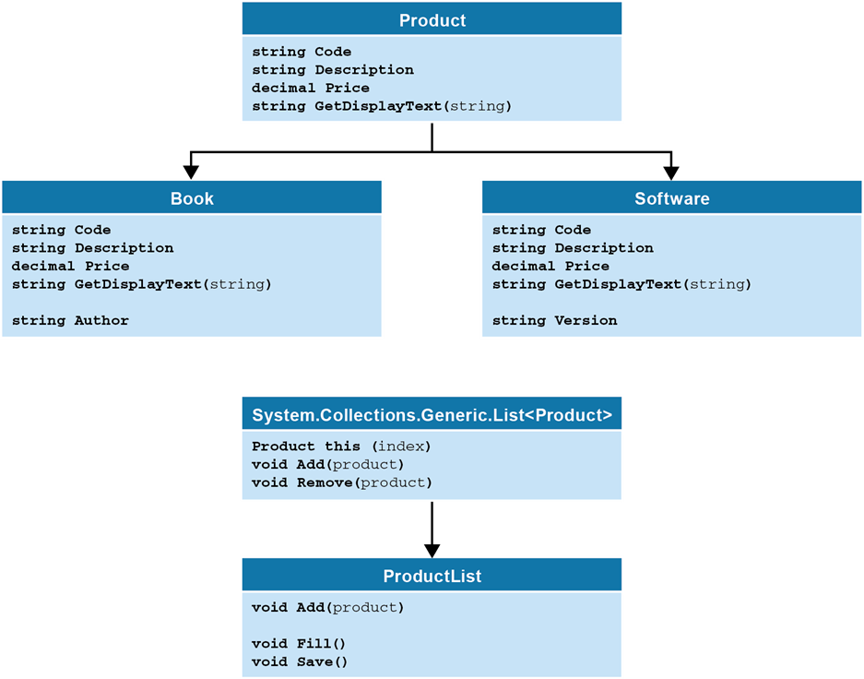
Business classes for a Product Maintenance application

Slide 8
The code for a simplified version of the Product base class
public class Product
{
public string Code { get; set; }
public string Description { get; set; }
public decimal Price { get; set; }
public virtual string GetDisplayText(string sep) =>
Code + sep + Description + sep + Price.ToString("c");
}

Slide 9
Access modifiers
Keyword Description
public Available to all classes.
protected Available only to the current class or to derived classes.
internal Available only to classes in the current assembly.
protected internal Available to the current class, derived classes in the current assembly, or derived classes in other assemblies.
private protected Available to the current class or to derived classes in the current assembly.
private Available only to the current class.

Slide 10
The syntax for creating subclasses
To declare a subclass
public class SubclassName : BaseClassName
To create a constructor that calls a base class constructor
public ClassName(parameterlist) : base(parameterlist)
To call a base class method or property
base.MethodName(parameterlist)
base.PropertyName
To hide a non-virtual method or property
public new type name
To override a virtual method or property
public override type name

Slide 11
The code for a Book class
public class Book : Product
{
public string Author { get; set; } // A new property
public Book(string code, string description, string author,
decimal price) : base(code, description, price)
{
this.Author = author;
// Initializes the Author field after
} // the base class constructor is called.
public override string GetDisplayText(string sep) =>
this.Code + sep + this.Description +
"( " + this.Author + ")" + sep +
this.Price.ToString("c");
}

Slide 12
Another way to override a method
public override string GetDisplayText(string sep) =>
base.GetDisplayText(sep) + "( " + this.Author + ")";

Slide 13
Three versions of the GetDisplayText() method
A virtual GetDisplayText() method in the Product base class
public virtual string GetDisplayText(string sep) =>
code + sep + price.ToString("c") + sep + description;
An overridden GetDisplayText() method in the Book class
public override string GetDisplayText(string sep) =>
base.GetDisplayText(sep) + sep + author;
An overridden GetDisplayText() method in the Software class
public override string GetDisplayText(string sep) =>
base.GetDisplayText(sep) + sep + version;

Slide 14
Code that uses the overridden methods
Book b = new Book("C#", "Murach's C#", "Anne Boehm",
59.50m);
Software s = new Software("NPTK",
".NET Programmer's Toolkit",
"4.5", 179.99m);
Product p;
p = b;
MessageBox.Show(p.GetDisplayText("\n"));
// Calls Book.GetDisplayText()
p = s;
MessageBox.Show(p.GetDisplayText("\n"));
// Calls Software.GetDisplayText()

Slide 15
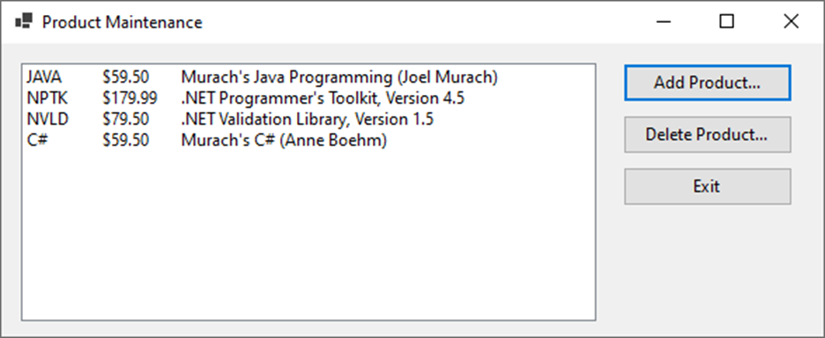
The Product Maintenance form

Slide 16
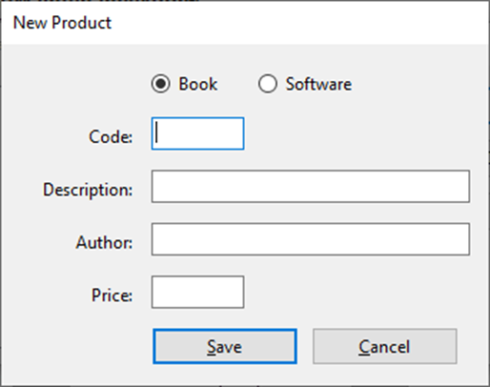
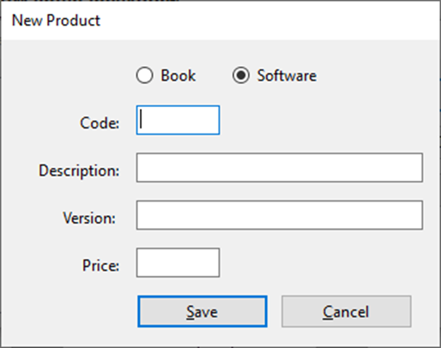
Two versions of the New Product form

Slide 17
The code for the Product class
public class Product
{
public Product() {}
public Product(string code, string description, decimal price)
{
this.Code = code;
this.Description = description;
this.Price = price;
}
public string Code { get; set; }
public string Description { get; set; }
public decimal Price { get; set; }
public virtual string GetDisplayText(string sep) =>
Code + sep + Price.ToString("c") + sep + Description;
}

Slide 18
The code for the Book class
public class Book : Product
{
public Book() {}
public Book(string code, string description, string author,
decimal price) : base(code, description, price)
{
this.Author = author;
}
public string Author { get; set; }
public override string GetDisplayText(string sep) =>
base.GetDisplayText(sep) + " (" + Author + ")";
}

Slide 19
The code for the Software class
public class Software : Product
{
public Software() {}
public Software(string code, string description, string version,
decimal price) : base(code, description, price)
{
this.Version = version;
}
public string Version { get; set; }
public override string GetDisplayText(string sep) =>
base.GetDisplayText(sep) + ", Version " + Version;
}

Slide 20
The code for the ProductList class
public class ProductList : List<Product>
{
// Modify the behavior of the Add method
// of the List<Product> class
public new void Add(Product p) => base.Insert(0, p);
// Provide two additional methods
public void Fill()
{
List<Product> products = ProductDB.GetProducts();
foreach (Product product in products)
base.Add(product);
}
public void Save() => ProductDB.SaveProducts(this);
}

Slide 21
Code for the Product Maintenance form (part 1)
public partial class frmProductMain : Form
{
public frmProductMain()
{
InitializeComponent();
}
private ProductList products = new ProductList();
private void frmProductMain_Load(object sender, EventArgs e)
{
products.Fill();
FillProductListBox();
}
private void FillProductListBox()
{
lstProducts.Items.Clear();
foreach (Product p in products)
lstProducts.Items.Add(p.GetDisplayText("\t"));
}

Slide 22
Code for the Product Maintenance form (part 2)
private void btnAdd_Click(object sender, EventArgs e)
{
frmNewProduct newForm = new frmNewProduct();
Product product = newForm.GetNewProduct();
if (product != null)
{
products.Add(product);
products.Save();
FillProductListBox();
}
}
private void btnDelete_Click(object sender, EventArgs e)
{
int i = lstProducts.SelectedIndex;
if (i != -1)
{
Product product = products[i];
string message = "Are you sure you want to delete "
+ product.Description + "?";

Slide 23
Code for the Product Maintenance form (part 3)
DialogResult button =
MessageBox.Show(message, "Confirm Delete",
MessageBoxButtons.YesNo);
if (button == DialogResult.Yes)
{
products.Remove(product);
products.Save();
FillProductListBox();
}
}
}
private void btnExit_Click(object sender, EventArgs e)
{
this.Close();
}
}

Slide 24
The code for the New Product form (part 1)
public partial class frmNewProduct : Form
{
public frmNewProduct()
{
InitializeComponent();
}
private Product product = null;
public Product GetNewProduct()
{
this.ShowDialog();
return product;
}
private void rbBook_CheckedChanged(object sender, EventArgs e)
{
if (rbBook.Checked)
{
lblAuthorOrVersion.Text = "Author: ";
txtAuthorOrVersion.Tag = "Author";
}

Slide 25
The code for the New Product form (part 2)
else
{
lblAuthorOrVersion.Text = "Version: ";
txtAuthorOrVersion.Tag = "Version";
}
txtCode.Focus();
}
private void btnSave_Click(object sender, EventArgs e)
{
if (IsValidData())
{
if (rbBook.Checked)
product = new Book(txtCode.Text,
txtDescription.Text,
txtAuthorOrVersion.Text,
Convert.ToDecimal(txtPrice.Text));
else
product = new Software(txtCode.Text,
txtDescription.Text,
txtAuthorOrVersion.Text,
Convert.ToDecimal(txtPrice.Text));
this.Close();
}
}

Slide 26
The code for the New Product form (part 3)
private bool IsValidData()
{
return Validator.IsPresent(txtCode) &&
Validator.IsPresent(txtDescription) &&
Validator.IsPresent(txtAuthorOrVersion) &&
Validator.IsPresent(txtPrice) &&
Validator.IsDecimal(txtPrice);
}
private void btnCancel_Click(object sender, EventArgs e)
{
this.Close();
}
}

Slide 27
The Type class
Property Description
Name Returns a string that contains the name of a type.
FullName Returns a string that contains the fully qualified name of a type, which includes the namespace name and the type name.
BaseType Returns a Type object that represents the class that a type inherits.
Namespace Returns a string that contains the name of the namespace that contains a type.
Method Description
GetType() Returns a Type object that represents the type of an object.

Slide 28
Code that uses the Type class to get information about an object
Product p;
p = new Book("CS80", "Murach's C# 8.0", "Anne Boehm",
59.50m);
Type t = p.GetType();
Console.WriteLine("Name: " + t.Name);
Console.WriteLine("Namespace: " + t.Namespace);
Console.WriteLine("FullName: " + t.FullName);
Console.WriteLine("BaseType: " + t.BaseType.Name);
The result that’s displayed on the console
Name: Book
Namespace: ProductMaintenance
FullName: ProductMaintenance.Book
BaseType: Product

Slide 29
How to test an object’s type
if (p.GetType() == typeof(Book))
Another way to test an object’s type
if (p.GetType().Name == nameof(Book))

Slide 30
Two methods that display product information
public void DisplayProduct(Product p) =>
MessageBox.Show(p.GetDisplayText());
public void DisplayBook(Book b) =>
MessageBox.Show(b.GetDisplayText());

Slide 31
Code that doesn’t require casting
Book b = new Book("C#", "Murach's C#", "Anne Boehm", 59.50m);
DisplayProduct(b); // Casting is not required because Book
// is a subclass of Product.
Code that requires casting
Product p = new Book("C#", "Murach's C#", "Anne Boehm", 59.50m);
DisplayBook((Book)p); // Casting is required because
// DisplayBook accepts a Book object.

Slide 32
Code that throws a casting exception
Product p = new Software("NPTK", ".NET Programmer's Toolkit",
"4.5", 179.99m);
DisplayBook((Book)p); // Will throw a casting exception
// because p is a Software object,
// not a Book object.
Code that uses the as operator
Product p = new Book("C#", "Murach's C#", "Anne Boehm", 59.50m);
DisplaySoftware(p as Software); // Passes null because p
// isn't a Software object

Slide 33
An abstract Product class
public abstract class Product
{
public string Code { get; set; }
public string Description { get; set; }
public decimal Price { get; set; }
public abstract string GetDisplayText(string sep);
// No method body is coded.
}
An abstract read-only property
public abstract bool IsValid
{
get; // No body is coded for the get accessor.
}

Slide 34
A class that inherits the abstract Product class
public class Book : Product
{
public string Author { get; set; }
public override string GetDisplayText(string sep) =>
this.Code + sep + this.Description + "( " +
this.Author + ")" + sep +
this.Price.ToString("c");
}

Slide 35
The class declaration for a sealed Book class
public sealed class Book : Product

Slide 36
How sealed methods work (part 1)
A base class named A that declares a virtual method
public class A {
public virtual void ShowMessage() =>
MessageBox.Show("Hello from class A");
}
A class named B that inherits class A and overrides and seals its method
public class B : A {
public sealed override void ShowMessage() =>
MessageBox.Show("Hello from class B");
}

Slide 37
How sealed methods work (part 2)
A class named C that inherits class B and tries to override its sealed method
public class C : B {
public override void ShowMessage() => // Not allowed
MessageBox.Show("Hello from class C");
}

Slide 38
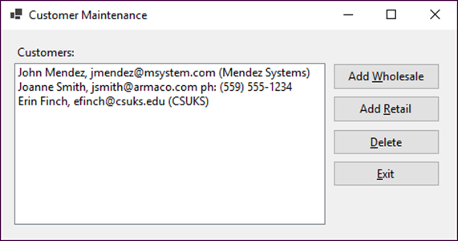
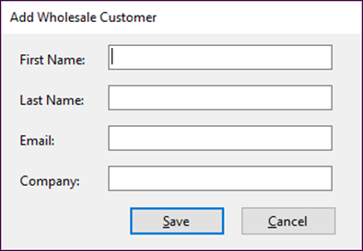
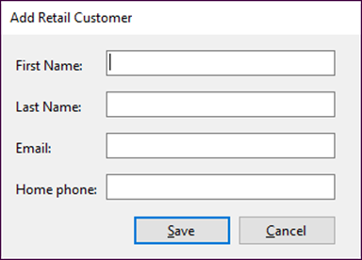
Exercise 14-1 Create a Customer Maintenance application that uses inheritance
Create classes for two types of customers that are derived from the Customer base class. Then, add the code that works with these classes.

Slide 39
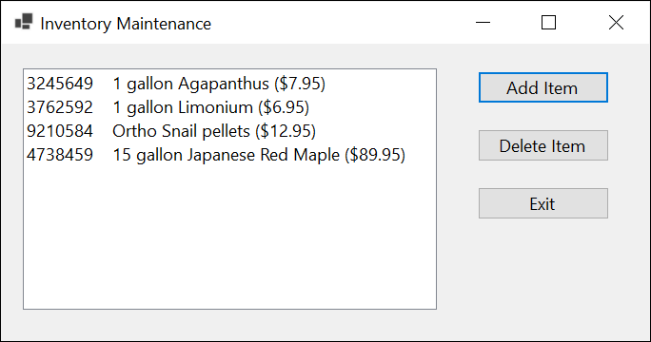
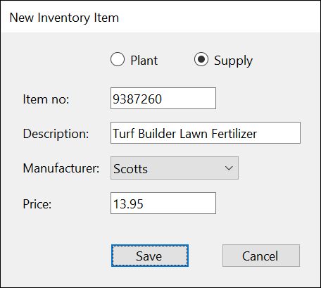
Extra 14-1 Use inheritance with the Inventory Maintenance application
Add two classes to the Inventory Maintenance application that inherit the InvItem class, and add code to the forms to provide for these new classes.

Slide 40
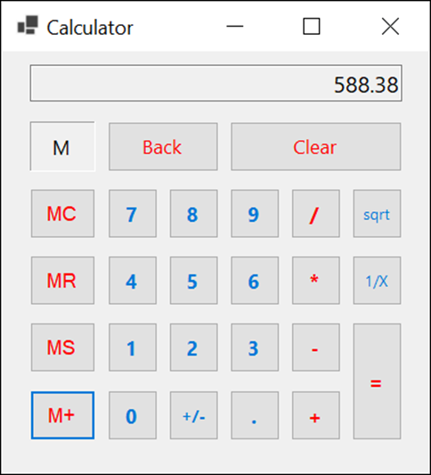
Project 3-4 Create a memory calculator
Create a form that lets the user perform the functions of a memory calculator.

Slide 41
Objectives (part 1)
Applied
Use any of the features of inheritance that are presented in this chapter as you develop the classes for your applications.
Knowledge
Explain how inheritance is used within the .NET classes and how you can use it in your own classes.
Explain why you might want to override the ToString(), Equals(), and GetHashCode() methods of the Object class as you develop the code for a new class.
Describe the use of the protected and virtual access modifiers for the members of a class.
Describe the use of polymorphism.
Describe the use of the Type class.

Slide 42
Objectives (part 2)
Describe the use of explicit casting when working with the objects of a base class and its derived classes.
Distinguish between an abstract class and a sealed class.

